Slide 1
Using Photometry to Determine IMF in Low-Metallicity Environments
Emily Apel, Rhonda Holton, Dr. Paul Scowen
Arizona State University

Slide 2
Goals
Method: Develop a photometric method for finding the initial mass function (IMF)
Question: Does the IMF in metal-poor environments vary with cooling of star-forming gas
Analysis: Connect results to our understanding of early star formation

Slide 3
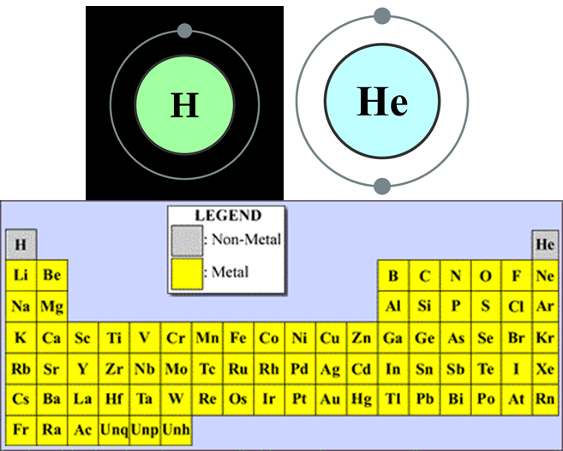
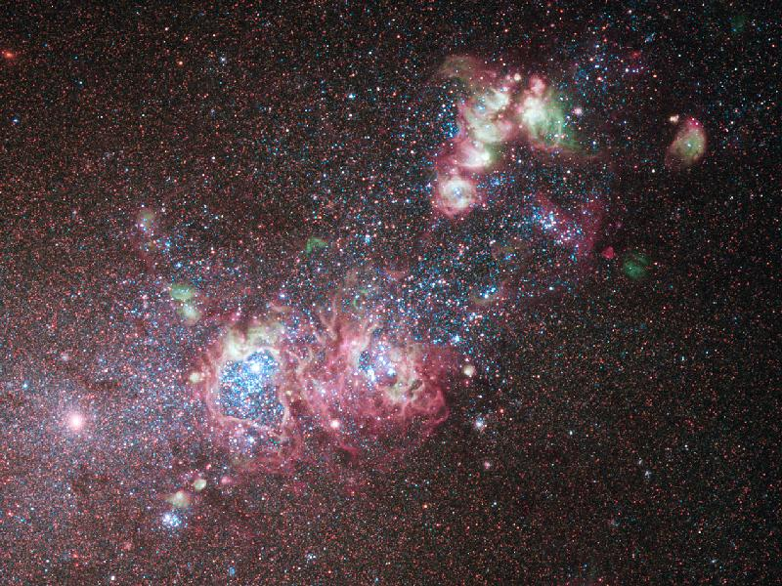
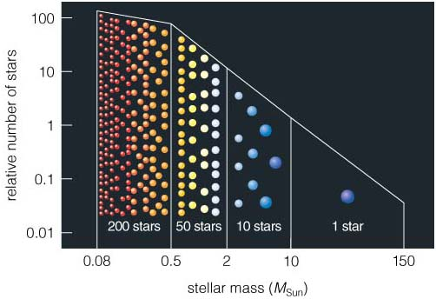
Background
Early universe → lack of heavier elements (metals)
Theoretically, less metals → IMF skewed towards higher masses
What is IMF?
Local dwarf galaxies will help us determine this since looking to early universe is difficult.
Credit: http://www.planetary.org/multimedia/space-images/charts/PeriodicTable-astro.html
https://commons.wikimedia.org/wiki/File:Electron_shell_002_Helium_-_no_label.svg
https://byjus.com/chemistry/uses-of-hydrogen/
Credit: NASA/ESA/Hubble Heritage (STScI/AURA)-ESA/Hubble Collaboration
Credit: http://lasp.colorado.edu/education/outerplanets/images_solsys/big/star_demographic.jpg
Target | 12 + [O/H] ^{[4]}
Barnard’s Galaxy | 8.1 ± 0.2
WLM | 7.8 ± 0.1
NGC 4214 | 8.2 ± 0.1
Sextans A | 7.5 ± 0.1

Slide 4
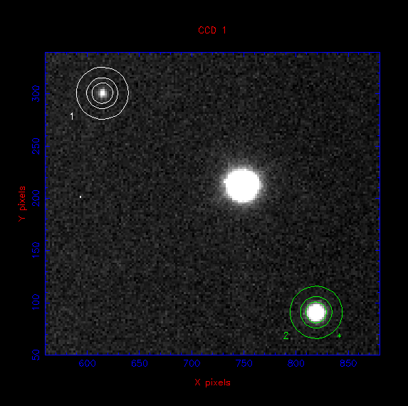
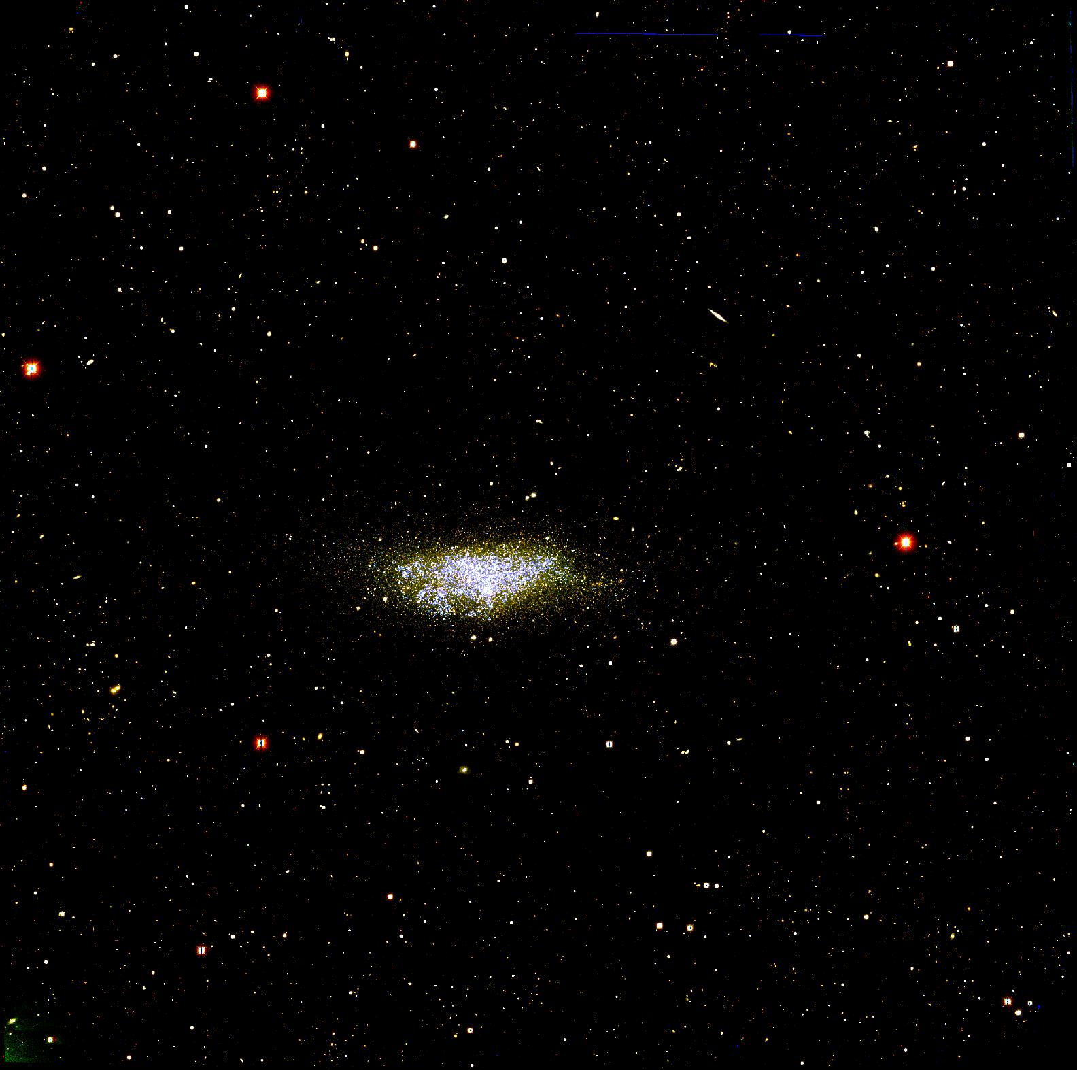
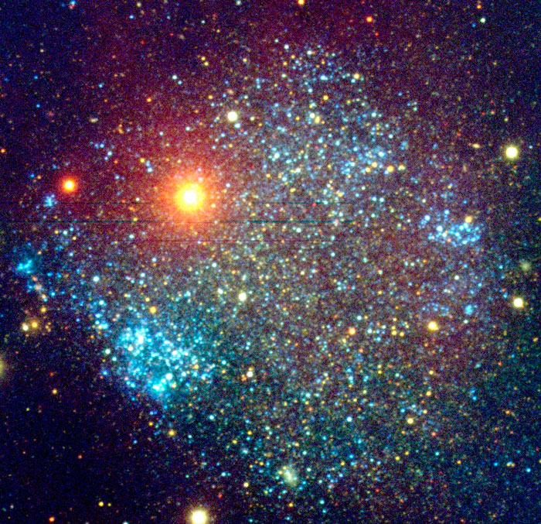
Methodology
Photometric analysis method development based on:
Target selection based on metallicity, distance, and available data
DAOPHOT for initial estimates of stellar flux in cluster stars
Aperture photometry of isolated stars is used to account for light scattered in the observing optics
Credit: S. D. Van Dyk (IPAC /Caltech) et al., KPNO 2.1-m Telescope, NOAO
Credit: Vik Dhillon
Credit: http://www2.lowell.edu/users/sholmes/wlm.html

Slide 5
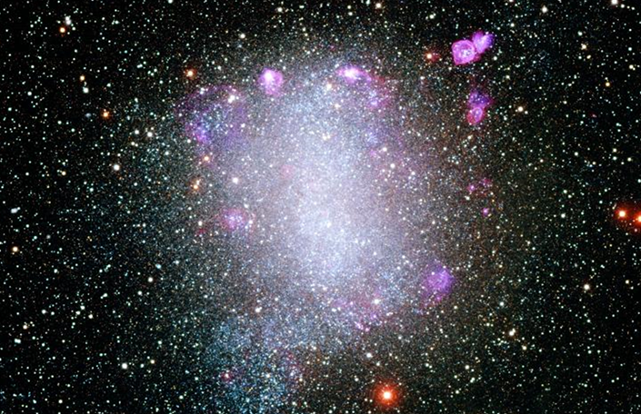
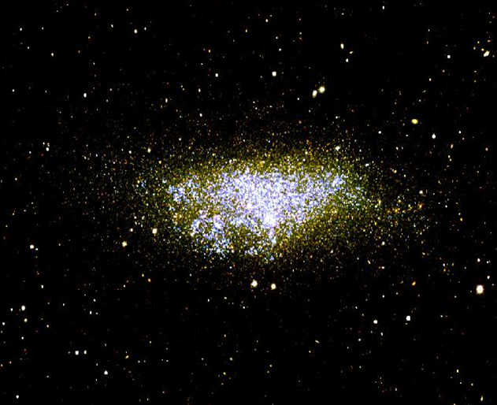


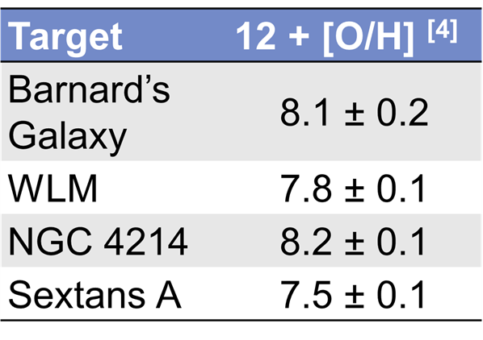


Target Selection
Barnard’s Galaxy
Credit: Local Group Galaxies Survey Team/NOAO/AURA/ NSF
Requirements: Low enough metallicity, local target, and data available
Data available from Hubble archive for F170W, F336W, and F555W filter
12 + [O/H] ≤ 8.0
Metallicity
Credit: http://www2.lowell.edu/users/sholmes/wlm.html
Credit: ESA/Hubble

Slide 6
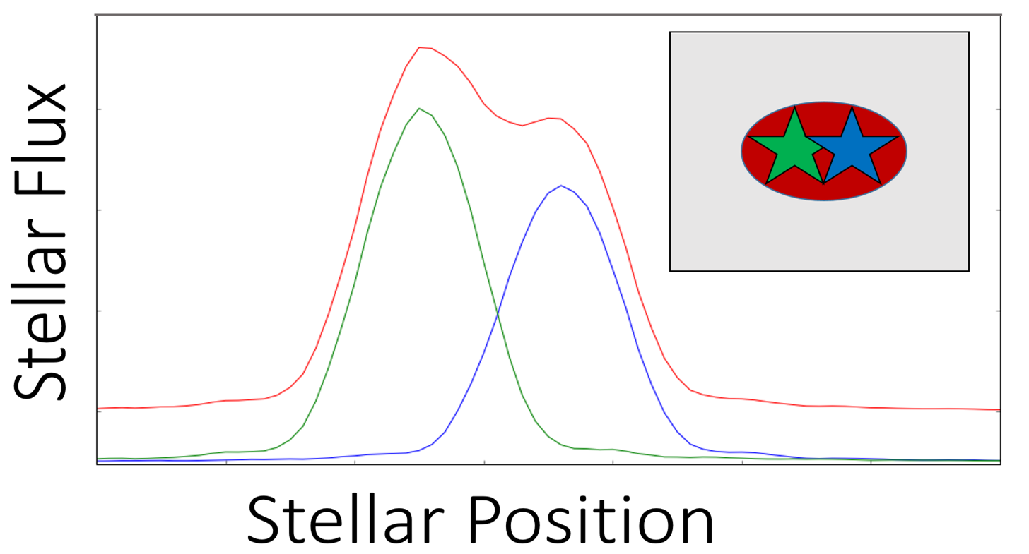
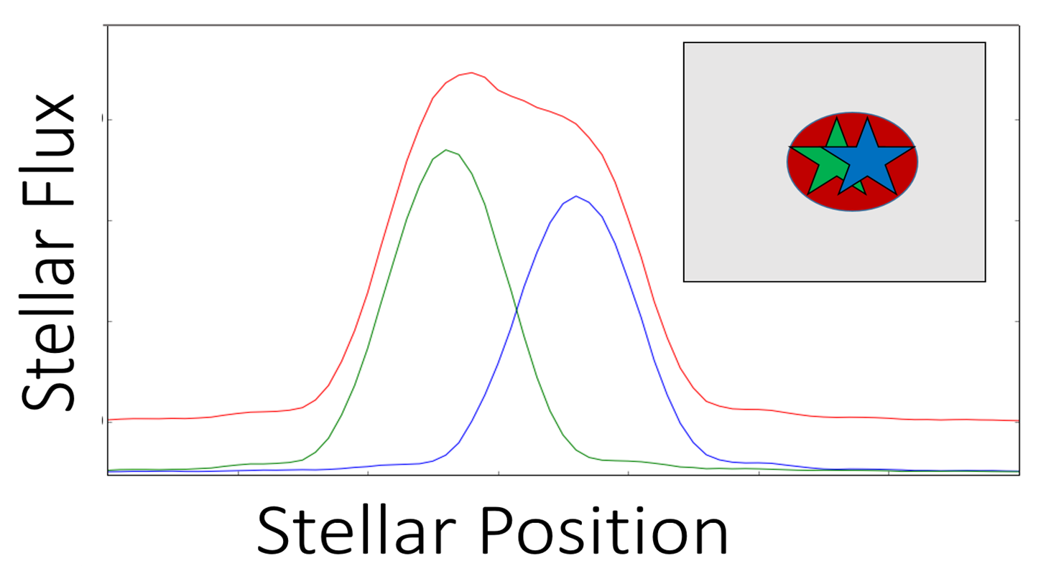

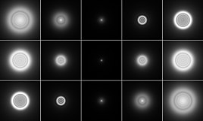
DAOPHOT
Best tool for handling spatial confusion
Used in conjunction with the point spread function (PSF) allows isolation of individual stars.
DAOPHOT helps us discern two flux peaks, providing individual fluxes AND locations
Barnard’s Galaxy
Credit: Local Group Galaxies Survey Team/NOAO/AURA/ NSF
Credit: https://en.wikipedia.org/wiki/Point_spread_function

Slide 7
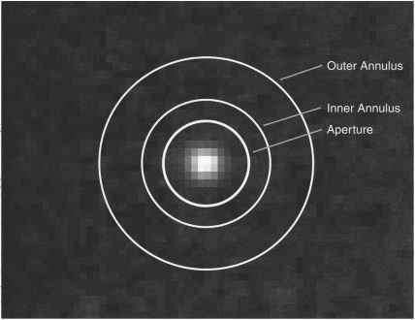
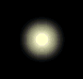
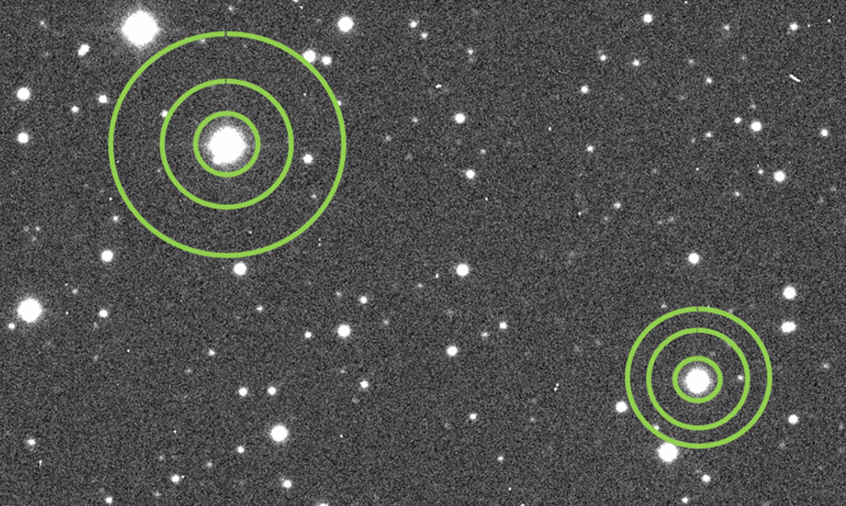


Aperture Photometry
Helps determine flux in differently sized annuli around a few, easily separated stars.
Ideally, center ring would capture all light, but some is scattered outwards.
Thus, outer rings help us find percentage scattered
Percentage scattered is then added to flux found using DAOPHOT
Credit: https://www.astronomyclub.xyz/image-processing/magnitudes-how-bright-is-this-star.html
Scattering
Credit: https://amazing-space.stsci.edu/resources/explorations/groundup/lesson/basics/g18a/

Slide 8

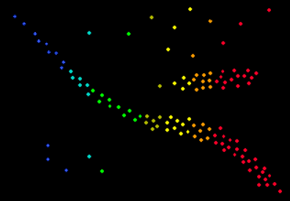

Calculation of mass from color and magnitude using massey’s method
stellar
Color
U – B = 0.72*(B – V)
Q = U – B + 0.72*(B – V)
Tells us the star’s magnitude
Brightest
Temperature
Luminosity
Mass
Hottest
Temperature
Coldest
Credit: http://www.astro.cornell.edu/academics/courses/astro201/hr_diagram.htm

Slide 9

And once we have the mass, we can find…
IMF
IMFs in galaxies of average metallicity values have a slope value close to the Salpeter value of -2.0
We expect low metallicity galaxies to skew towards higher masses, so we expect an IMF of slope GREATER THAN -2.0
More higher mass stars means slope will become less negative
Credit: http://lasp.colorado.edu/education/outerplanets/images_solsys/big/star_demographic.jpg

Slide 10
Acknowledgements
NASA Space Grant Program
Arizona State University
Dr. Paul Scowen
Rhonda Holton

Slide 11
Questions?

